Slide 1

What is Odoopath4Startups

Slide 2
Why ERP?
💡 When is the right time for ERP?
Is Excel enough?
Why should a startup use ERP instead of Excel?

Slide 3
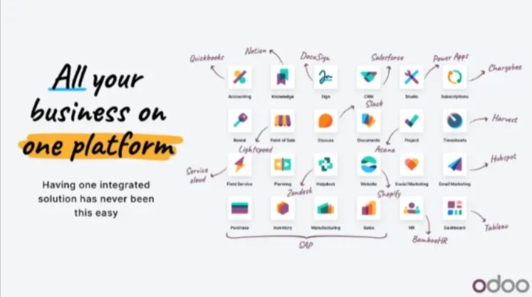
Why Odoo?

Slide 4
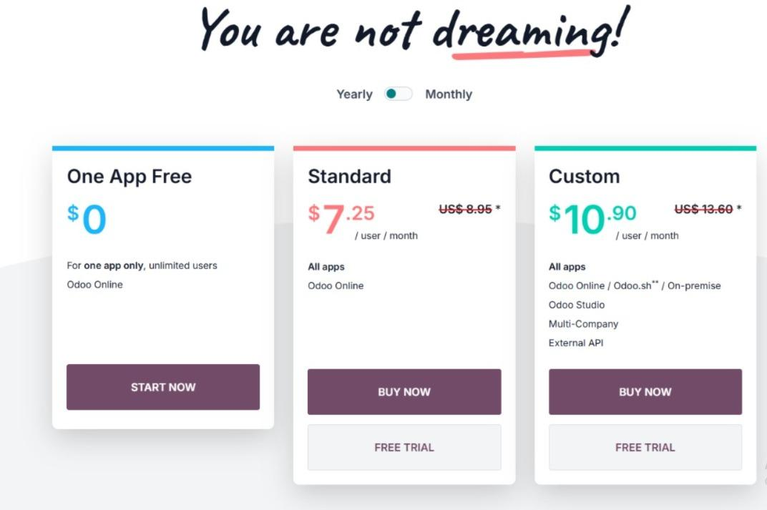

Slide 5

Why the Accounting module?
What’s inside Accounting module?

Slide 6
Understanding the Company Workflow

Slide 7
Analyzing Client Needs

Slide 8
ERP Capacity Analysis

Slide 9
Challenges and Solutions

Slide 10
Mapping Startup Operations to Odoo Features

Slide 11
ERP Implementation Formula

Slide 12
What a Startup Gains in 30 Days with Odoopath
Structured financial workflows using only the Accounting module
Accurate customer and vendor tracking without full CRM or purchase modules
Timely invoice and bill recording with built-in document attachments
Clear cash flow visibility through real-time reporting and dashboards
Organized transaction tracking via analytic accounts and tags
Minimal training required — simple SOPs and activity reminders
Centralized storage of financial documents (quotes, receipts, approvals)
A reliable organizational tool (Odoo) from day one — not just spreadsheets
Zero subscription fees and no need for customization
Fully scalable setup ready to expand with business growth
Confidence in financial compliance and audit readiness from day one

Slide 13
No ERP Subscription, No Customization Just Smart Use of Odoo Accounting Features!

Slide 14
Tailored ERP Implementation Strategy

Slide 15
Conclusion
Lean Startup isn't about building less. It's about building smart. Odoopath4Startups proves that even one tool when used creatively can lead to an entire system transformation.
This is not just ERP implementation... this is Lean ERP thinking in action and a replicable framework for early-stage startups.

